Slide 1
DIP MINI PROJECT
MEASURING THE DIAMETER OF AN OBJECT WITHIN AN IMAGE
SUBMITTED BY
ANANDU ASHOK – B160913EC
DATE 4TH APRIL 2019 DAWN R MANUEL-B160152EC

Slide 2
INTRODUCTION
Measuring objects within an image or frame can be an important capability for many applications where computer vision is required instead of making physical measurements.
The MATLAB application can be used to calculate the size of a 3D object described in the 2D plane of the image using its standard in built functions and alogorithms.
This process finds a lot of lot of practical applications such as measuring the size of tumors present in human body or measuring the size of cracks and vents in railway systems from their images

Slide 3
OBJECTIVE
The aim of our project is to obtain the diameter of an object within an image using the MATLAB functions
A MATLAB program code is made to import an image, segment the image in order to isolate the desired object from its background and then using the MATLAB functions to determine the object’s diameter
Basic knowledge on MATLAB is required

Slide 4
STEPS INVOLVED
IMPORTING THE IMAGE
SEGMENTING THE IMAGE
NOISE REMOVAL
MEASURING THE SIZE

Slide 5
IMPORTING THE IMAGE
The code used for importing the image is
clear;
clc;
obj=imread(‘ball.jpg’)
imshow(obj)
The command imread reads an image and converts it into a “3-dimensional” matrix in the RGB color space. The image used in this tutorial is ball.jpg. The ‘imshow code’ is used to view the imported image.

Slide 6

Original image ball.jpg

Slide 7
SEGMENTING THE IMAGE
The code used for segmenting is given as
red = obj(:,:,1);
green = obj(:,:,2);
blue = obj(:,:,3);
Figure(1)
Subplot(2,2,1); imshow(obj); title (‘original image’);
Subplot(2,2,2); imshow(red); titlle (‘red plane’);
Subplot(2,2,3); imshow(green); title(‘green plane’);
Sublot(2,2,4); imshow(blue); title(‘blue plane’);
figure(2)
level = .37;
bw2 = im2bw(blue,level);
subplot(2,2,1);imshow(bw2); title(‘blue plane thresholded);
The first step taken is to divide the image into three images based on the intensities of each red, green and blue component within the image. This is color based segmentation.

Slide 8
SEGMENTATION (CONTINUED)
Image Thresholding takes an intensity image and converts it into a binary image based on the level desired (See line 25). A value between 0 and 1 determines which pixels (based on their value) will be set to a 1 (white) or 0 (black)).
In this image blue plane provides the best contrast between the object and the background.

Slide 9
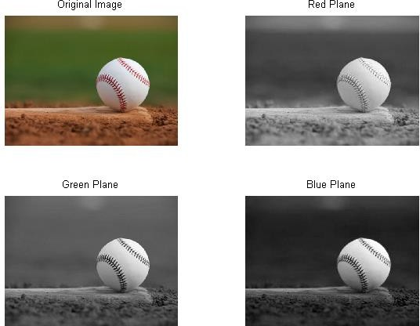
Colour thresholding

Slide 10
REMOVING NOISE
The noise present in the image has to be removed to improve the accuracy of measurement
The code is given as
fill = imfill(bw2,’holes’);
subplot(2,2,2); imshow(fill); tite(‘holes filled’);
clear = (2,2,3); imshow(clear); imclearborder(fill);
subplot (2,2,3); imshow(clear); title(‘remove blobs onborder);
se = strel(‘disk’,7);
open = imopen(fill,se);
subplot(2,2,4); imshow(open); title(‘remove small bobs’);
The ‘imfill’ function is used to fill the holes in the image. The “imclearborder” function is used remove the blobs across the borders. Afterwards blobs smaller than 7 pixels are removed.

Slide 11
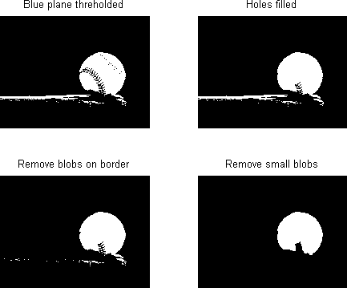
Complete segmentationa and noise removal

Slide 12
MEAURING THE DIAMETER
The image is in the binary form with all the noise removed and hence its easier to measure its size.
The code for measuring the diameter is
diameter = regionprops(pen,’majoraxislength’0
figure(3)
imshow(obj)
d= imdistline;
The ‘regionprops’ function is used to calculate the majoraxis length of the blob.The‘imdistline’ function is used to verify the measurement by including a line to physically measure the diameter.

Slide 13
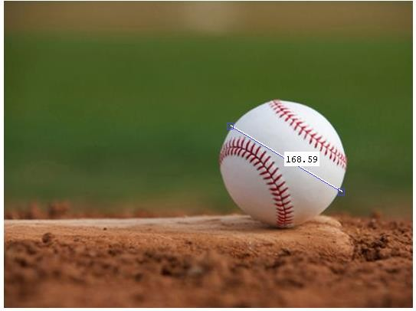
RESULT
The result obtained by using the codes is found to approximately equal to the actual length of the major axis measured using the ‘imdistline’ function.

Slide 14
CONCLUSION
The MATLAB application thus helps us finding out the size of 3D objects in image planes with minimum error and finds its use in may practical situations when physical measurement of the size of objects is not possible

Slide 15
THANK YOU

